Slide 1

Timetable Management System for FSKSM
AD2122J-Alpha
Mohd Razak Bin Samingan
Ruhul Quddus Tamim
Md Yusuf Bin Forkan
Shafi Ahmed
Syafiq Ibnu Ramadhan

Slide 2
Project Introduction
Existing Desktop type Web-based is only available, cannot be viewed on cell phone apps.
Current website are hard and trouble to understand because the information are everywhere.
Improvements need to be done are:
1. UI that is easier to navigate and eye-pleasing to users
2. Filter function will be provided in order to view only useful information
3. Search function to search for students more efficiently

Slide 3
Project Stakeholders
Mohd Razak Samingan(Project Manager)
Ruhul Quddus Tamim(Team Leader)
Md Yusuf Bin Forkan(Application Developer)
Shafi Ahmed(System Analyst)
Syafiq Ibnu Ramadhan(UI/UX Designer)

Slide 4
Problem Statement
Current website is not responsive and not available on mobile apps.
The UI is not suitable and user-friendly to be displayed on mobile devices.
There are few extra unessential features on the website, for instance, analysis and curriculum.

Slide 5
Proposed System – FSKSM(Mobile)
To propose a system that is organized mobile-layout website and apps.
To propose a system that is user-friendly mobile design.
To propose a system that uses JSON services from FSKSM E-Learning to obtain data needed in JSON format and retrieve data via JSON services and applied it into the code.
To propose a system that loads the current timetable for the current semester for both students and lecturers.

Slide 6
Scope of Project
The proposed system is only used by the students and lecturers of UTM from the School of Computing.
It is only intended for the use of viewing timetable purpose only.
The lecturers can be able to view all the enrolled students.

Slide 7
Uses of Technology
Draw.io - For drawing Flowchart, UML
Trello – Keep track of progress of project
HTML, CSS – Backbone of the webpage
JavaScript – Simple client-side logic
Bootstrap – Responsive web design
JSON - JSON services from FSKSM E-Learning to obtain data needed in JSON format
Angular JS - Retrieve data via JSON services and applied it into the code
AJAX - To send HTTP requests for data by JavaScript calls without having to submit a form.

Slide 8
Benefits and Values to UTM, School of Computing
Speed up the process of finding timetables for students because of better filtering data.
Lecturer can search students more efficiently hence less time consuming.
Lecturer and students can download their own timetables.

Slide 9
Team Member Roles
Member | Roles | Description
Ruhul Quddus Tamim | Team Leader | Plan Project Supervise Progress Organize Team
Md Yusuf Bin Forkan | Application Developer | Code to Develop the work
Shafi Ahmed | System Analyst | Analyze the work In charge of testing the app
Syafiq Ibnu Ramadhan | UI/UX Designer | Design the interface Reflect on user demands

Slide 10
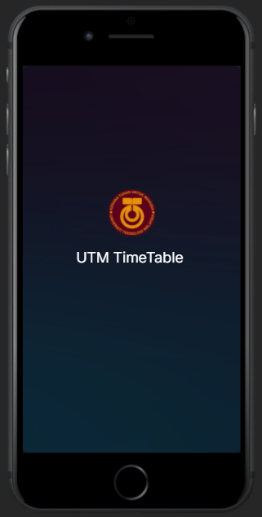
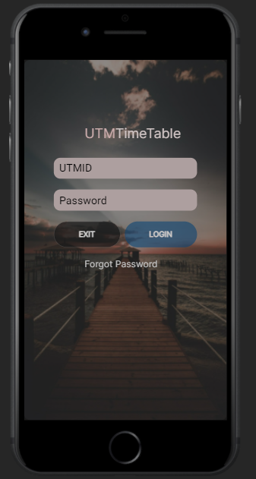
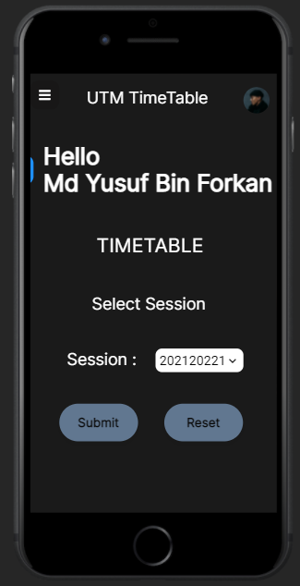
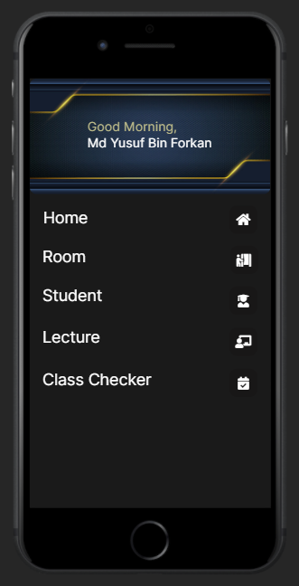
UI Design

Slide 11
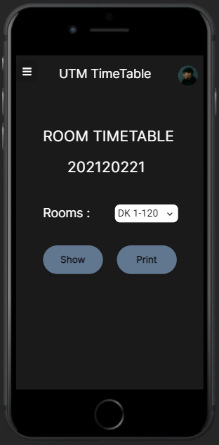
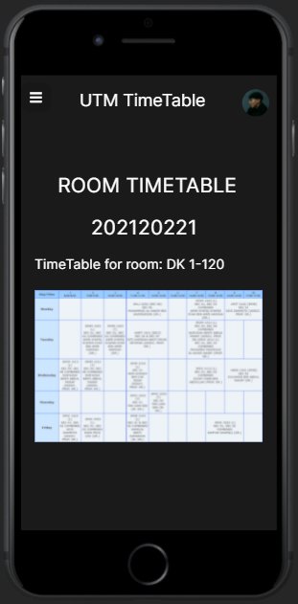
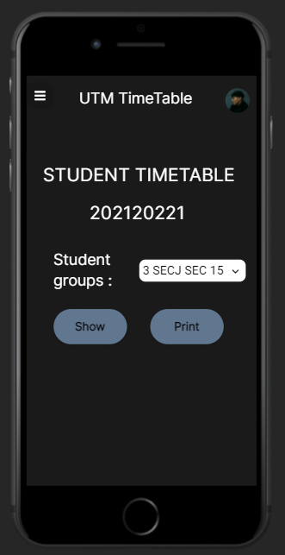
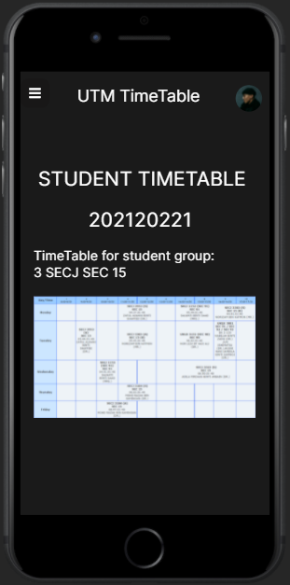
UI Design

Slide 12
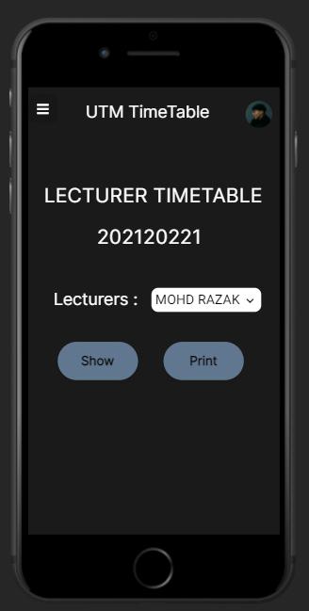
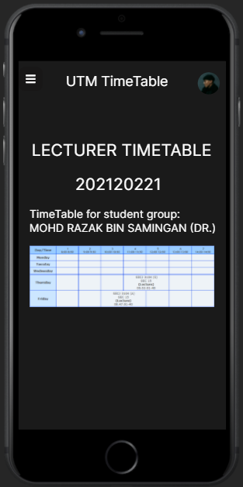
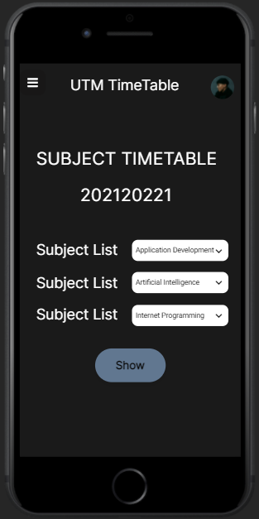
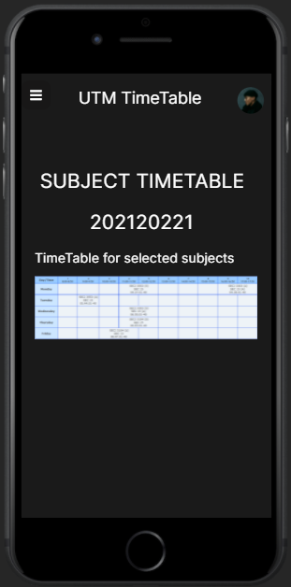
UI Design

Slide 13

Project Summary
To conclude, mobile based website will benefit to all, which include the university, the lecturers and the students. Since the case study given already provided all the information and data on the website, it will be easier for us to deploy the whole project.

